Slide 1
OpenVINO Workshop
July 2018

Slide 2
Agenda
Labs
Basic Inference Engine Examples
A Classification example
An End to End Object Detection Example
HW Acceleration with Movidius™ Neural Compute Stick
Free Exercises
Q&A

Slide 3
Before we start

Slide 4
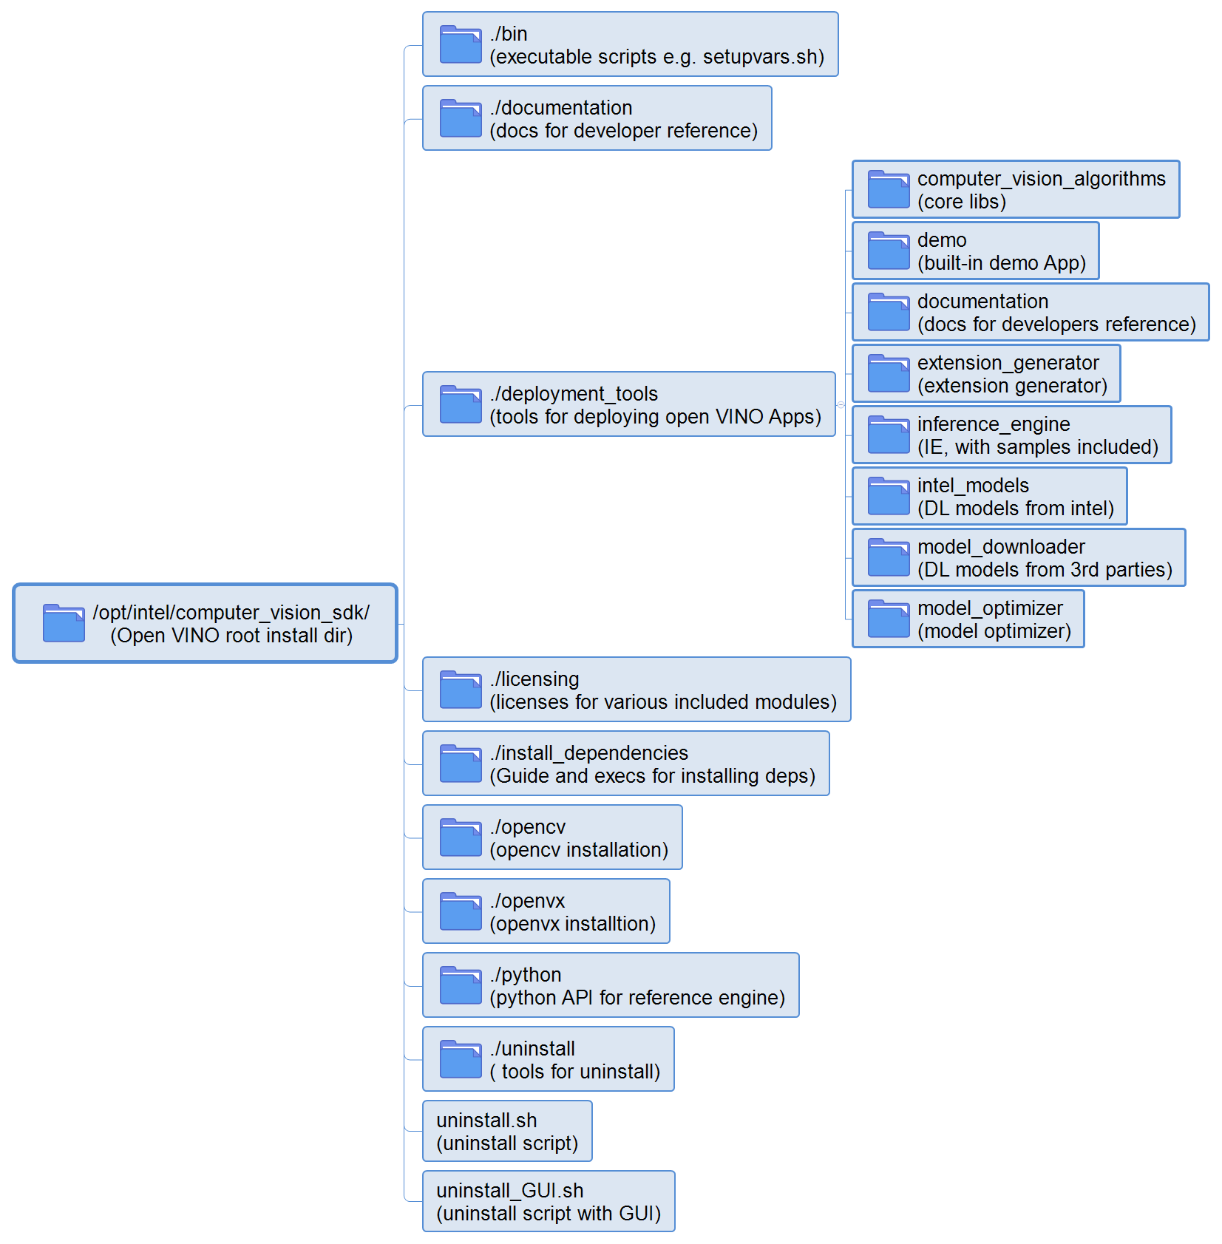
Open VINO installation directory

Slide 5
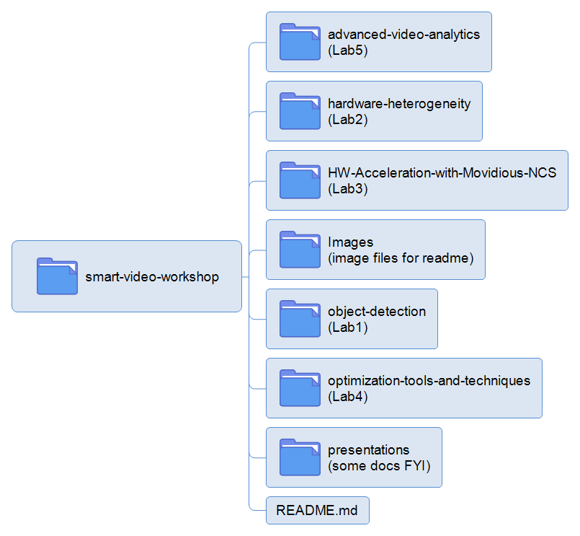
Workshop content introduction

Slide 6
Code Samples
Deep Learning
Image Classification (AlexNet/ GoogLeNet)
Image Segmentation
( FCN8.)
Object Detection
(Faster R-CNN )
Object Detection for Single Shot Multibox Detector (SSD)
Neural Style Transfer
Validation Application (check model accuracy)
OpenCV
People Detection (HOG) Colorization (DNN)
Custom OpenCL™ Kernel
Dense Optical Flow
Facial Recognition
OpenVX
Auto Contrast
Custom OpenCL Kernel
Heterogeneous Basics
Advanced OpenVX
Domain specific OpenVX workloads

Slide 7
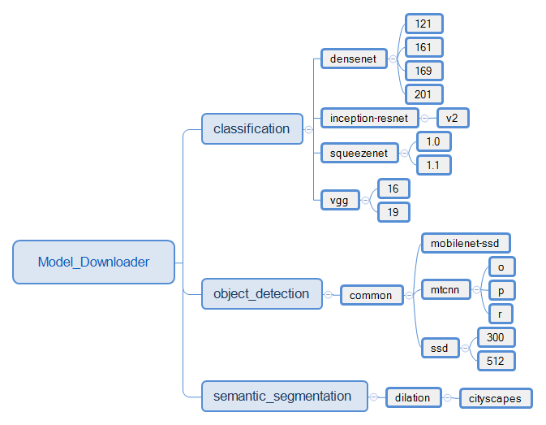

Open VINO Model Downloader directory

Slide 8
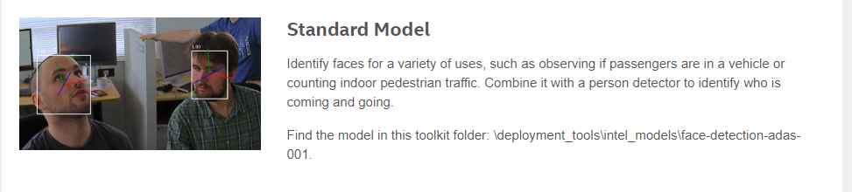
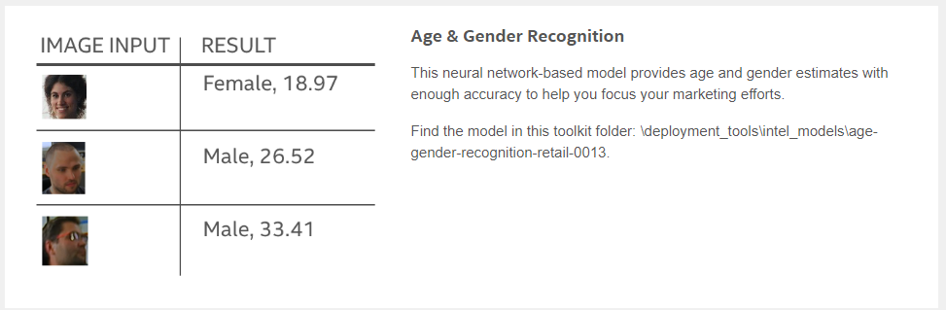
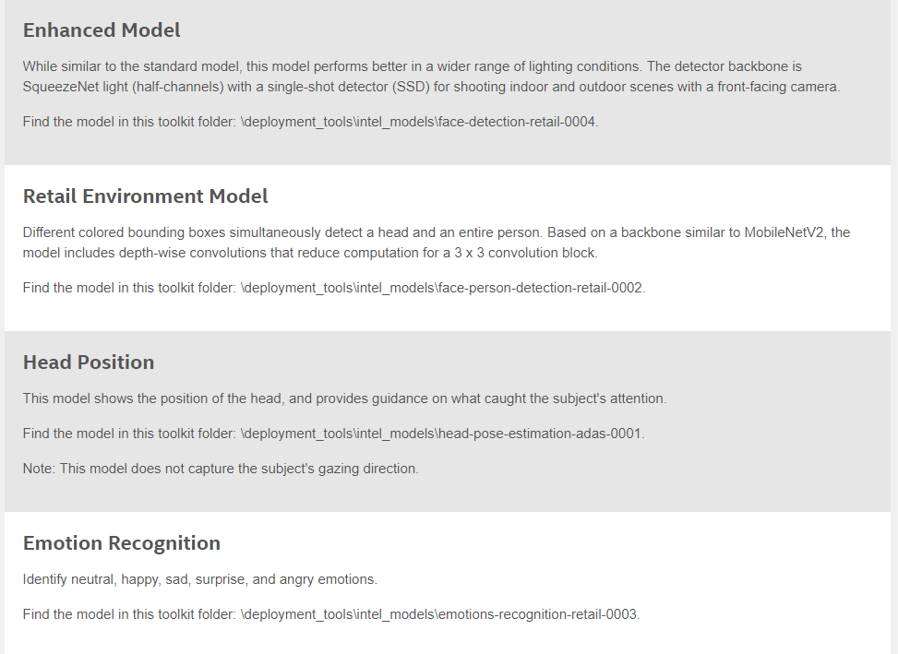
Face Detection
https://software.intel.com/en-us/OpenVINO-toolkit/documentation/pretrained-models

Slide 9
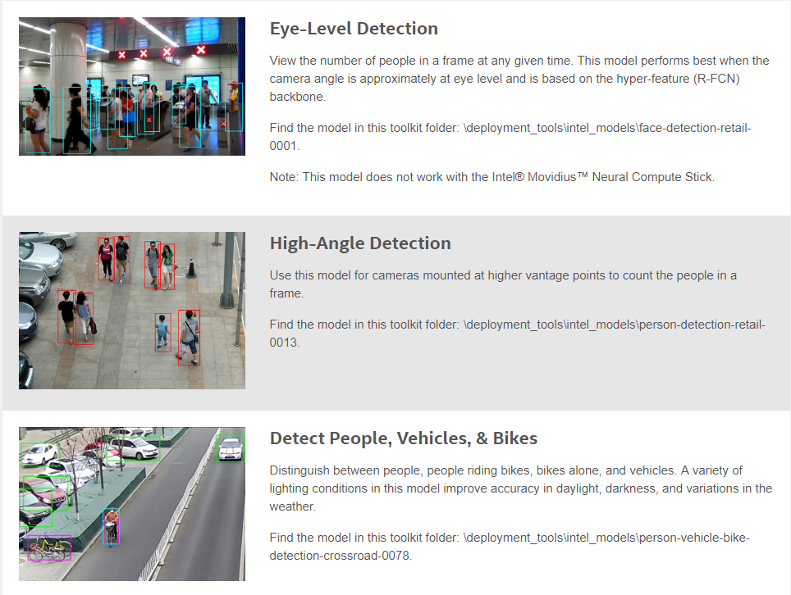
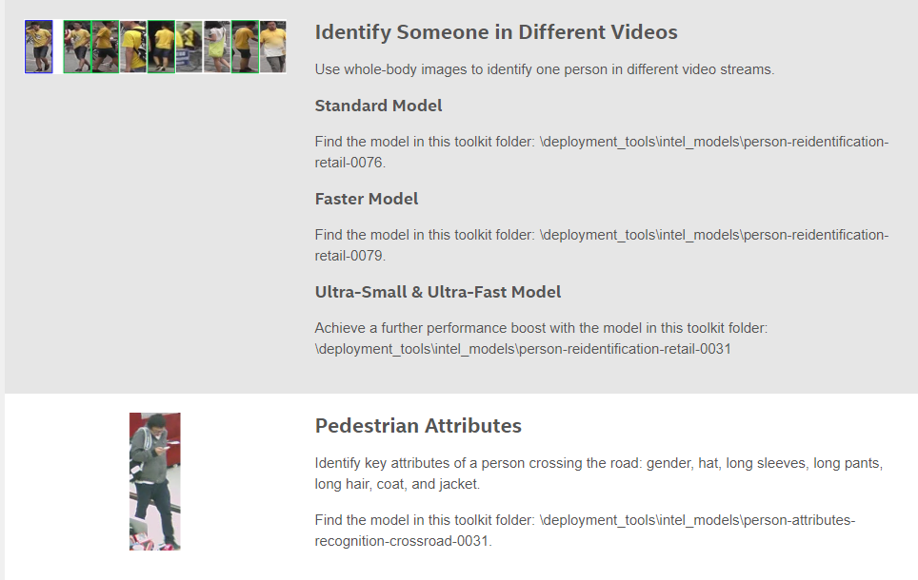
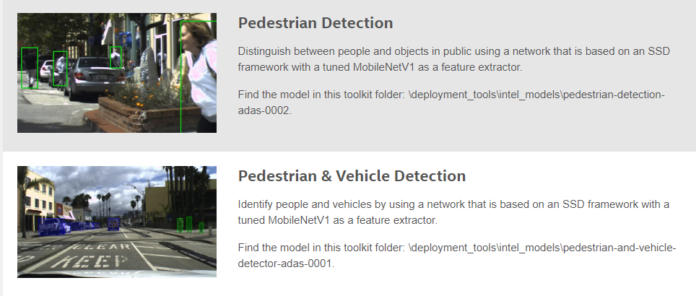
Human Detection
https://software.intel.com/en-us/OpenVINO-toolkit/documentation/pretrained-models

Slide 10
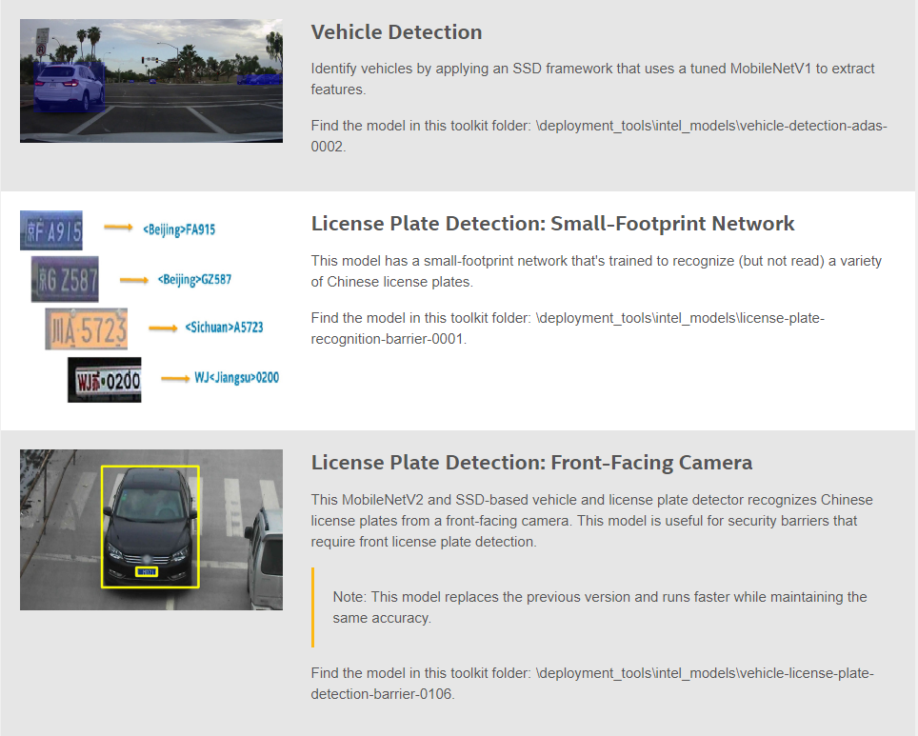
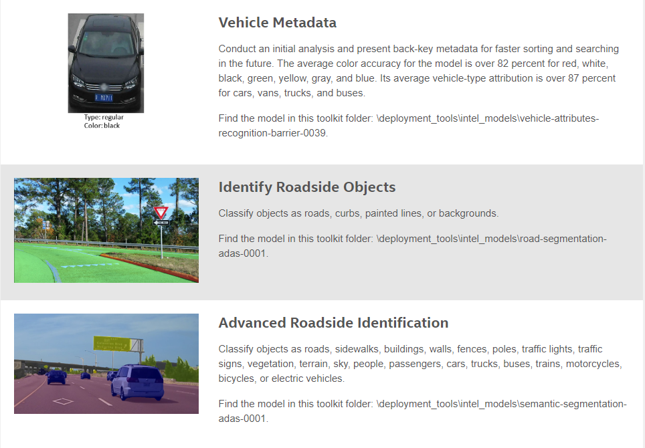
Vehicle Feature Recognition
https://software.intel.com/en-us/OpenVINO-toolkit/documentation/pretrained-models

Slide 11
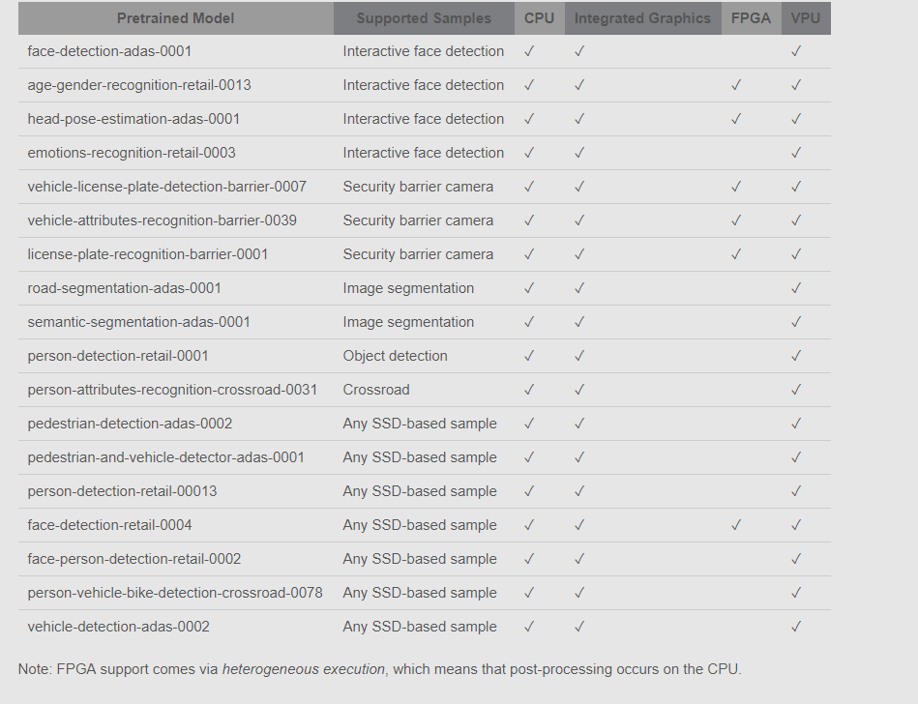
Supported Samples
https://software.intel.com/en-us/OpenVINO-toolkit/documentation/pretrained-models

Slide 12
Lab1: Basic Inference Engine Examples

Slide 13
Deep Learning Application Deployment
Traditional
With OpenVINO™ Toolkit
Pretrained Models
User Application + Inference
User Application + Inference
User Application + Inference
Video/Image/Speech
One-Time Process
Model Optimizer
Model Optimizer
.xml, .bin
Pretrained Models
User Application + Inference Engine
User Application + Inference Engine
Video/Image/Speech

Slide 14
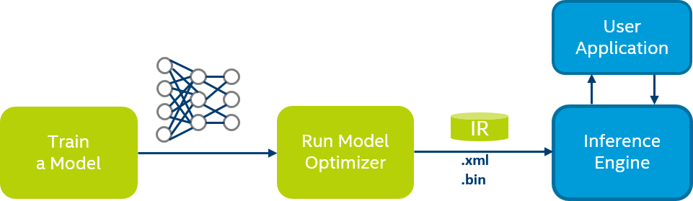
Model Optimizer
Converts models from various frameworks (Intel® Optimization for Caffe*, Intel® Optimization for TensorFlow*, Apache* MXNet*)
Converts to a unified model (IR, later n-graph)
Optimizes topologies (node merging, batch normalization elimination, performing horizontal fusion)
Folds constants paths in graph
Notes:
Design and Train your network
Convert & Optimize your network
Test and Validate on actual hardware/environment , Get Feedback:
is accuracy good? performance good? What is the best batch?
Deploy using your chosen IR model.

Slide 15
Inference Engine
Simple and unified API for inference across all Intel® architecture
Optimized inference on large Intel® architecture hardware targets (CPU/GEN/FPGA)
Heterogeneous support allows execution of layers across hardware types
Asynchronous execution improves performance
Futureproof/scale development for future Intel® architecture processors
Applications/Service
Inference Engine Runtime
Inference Engine Common API
FPGA Plugin
Intel® MKL-DNN Plugin
clDNN Plugin
Intel® Movidius™
Plugin
Plugin Architecture
DLA
Intrinsics*
OpenCL™
Intel® Movidius™ API
Intel® Arria® 10 FPGA
CPU: Intel® Xeon®/Intel® Core™/Intel Atom®
Intel Integrated
Graphics (GPU)
Intel® Movidius™ Myriad™ 2
Notes:
Heterogeneity - Device affinities. User can specify (example) "HETERO: FPGA,CPU" to fallback to CPU for layers that FPGA does not support. This can also be used for CPU+GPU cases when User has custom layers implemented on CPU only and wants to execute rest of topology on GPU without obligation to rewrite the custom layer for GPU
Async API usage improves overall frame-rate of the application, allowing to do other things (like next frame decoding), while accelerator is busy with inference of the current frame.
CPU - MKLDNN Plugin
Supports FP32, INT8 (planned)
Supports Intel® Xeon®/Core®/Atom® platforms (https://github.com/01org/mkl-dnn )
GPU – clDNN Plugin
Supports FP32 and FP16 (recommended for most topologies)
Supports Gen9 and above graphics architectures (https://github.com/01org/clDNN)

Slide 16
Workflow
Initialize
Initialization
Load model and weights
Set batch size (if needed)
Load inference plugin (CPU, GPU, FPGA)
Load network to plugin
Allocate input, output buffers
Fill Input
Infer
Interpret Output
Main Loop
Fill input buffer with data
Run inference
Interpret output results

Slide 17
Hands-on Lab1: Classification + Object Detection Examples
1-1：Classification + squeezenet + img
App | type | input | model | output
classification_sample | classification | img | squeezenet | The classification result on console
1-2：Face Detection + face-detection-retail-0004 via Camera
App | type | input | model | output
interactive_face_detection_sample | object detection | Camera | face-detection-retail-0004 | The detected faces on the screen

Slide 18
Lab2: HW Acceleration with Movidius™ Neural Compute Stick

Slide 19
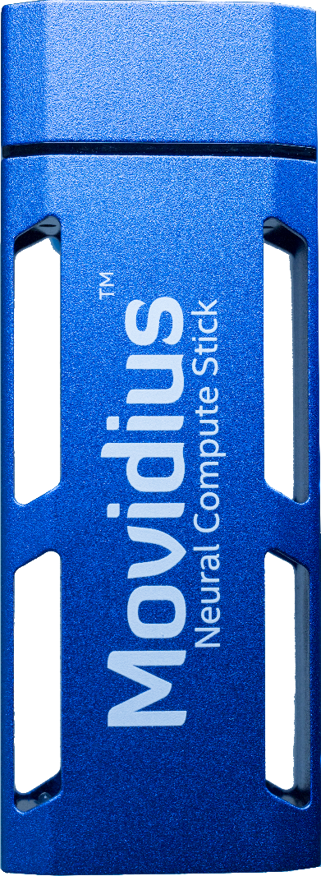
Intel® Movidius™ Neural Compute Stick Redefining the AI Developer Kit
Neural network accelerator in USB stick form factor
Tensorflow* and Caffe* and many popular frames are supported
Prototype, tune, validate, and deploy deep neural networks at the edge
Features the same Intel® Movidius™ Vision Processing Unit (VPU) used in drones, surveillance cameras, virtual reality headsets, and other low-power intelligent and autonomous products
Notes:
I like to call this as “AI developer kit redefined!”. Imagine a deep learning engine inference engine on a USB stick. You don't need any additional heat sink, no cooling fans, no cables, no additional power supply. All you need is just the NCS, and any system that’s running Linux based operating system. This is the developer kit that doesn’t require a large desk space to set up. As developer evangelist for NCS, I travel quite a bit, so form-factor is super important. When I have those dead times waiting for my flights all I have do is just take Movidius NCS out of my bag, plug it into my laptop, which I'm already carrying and I am ready to start writing applications or start profiling my networks. Any place any time. So I love the way this part has turned out and I hope you will like it when you get your hands on it as well.
No developer kit is compelte without a set of software tools, so we created the NC SDK…

Slide 20
Hands-on Lab2: Run Classification Example / Object Detection Example with Movidius NCS
2-1：Classification + squeezenet + img + NCS
App | type | input | model | output
classification_sample | classification | img | squeezenet | The classification result on console
2-2：Face Detection + face-detection-retail-0004 + Camera + NCS
App | type | input | model | output
interactive_face_detection_sample | object detection | Camera | face-detection-retail-0004 | The detected faces on the screen

Slide 21
Lab3：Free exercises

Slide 22
Hands-on Lab3：Please try the below apps + models freely
App Name | Type | Model (-m) | Input (-i) | Input | Output
classification_sample | Classification | vgg19 | Image | Car.png | console log
 |  | squeezenet1.1 |  | Street1.jpg
 |  | inception-resnet-v2 |  | Street2.jpg
 |  | densenet-121 |  | …
object_detection_demo_ssd_async | SSD | mobilenet-ssd/ssd300/ssd512 | Video | Cars1.mp4 /dev/video0 | on screen
 |  | face-detection-adas-0001 | Cam | …
 |  | pedestrian-and-vehicle-detector-adas-0001
interactive_face_detection_sample |  | pedestrian-detection-adas-0002 | Image | 2007_005902.jpg 2007_005972.jpg | on screen
 |  | person-detection-retail-00013 | Video | /dev/video0
 |  |  | Cam | Cars1.mp4 …
 |  | face-detection-retail-0004
 |  | person-vehicle-bike-detection-crossroad-0078
segmentation_sample | Image Segment | semantic-segmentation-adas-0001 | Image | 2008_000028.jpg 2008_000050.jpg … | file
 |  | road-segmentation-adas-0001 |  |  | (out_0.bmp)
Example（./lab.py –h to get help info）
./lab.py classification_sample ­-i car.png -­m squeezenet1.1

Slide 24
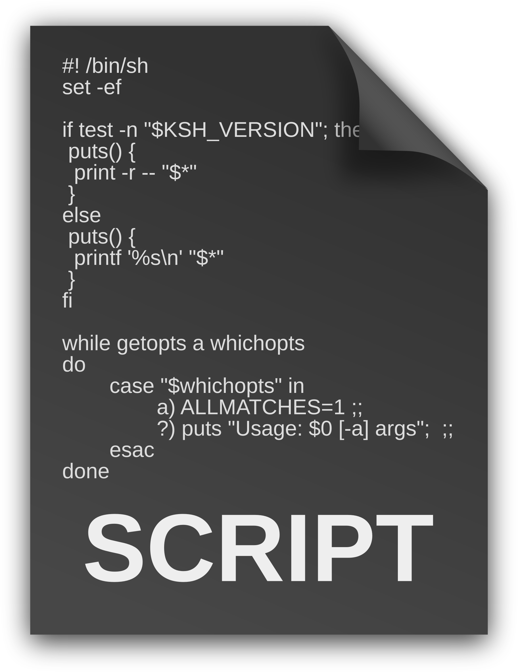
Open VINO installation directory
./bin
(executable scripts e.g. setupvars.sh)
computer_vision_algorithms
(core libs)
./documentation
(docs for developer reference)
demo
(built-in demo App)
./deployment_tools
(tools for deploying open VINO Apps)
documentation
(docs for developers reference)
./licensing
(licenses for various included modules)
extension_generator
(extension generator)
./install_dependencies
(Guide and execs for installing deps)
inference_engine
(IE, with samples included)
./opencv
(opencv installation)
intel_models
(DL models from intel)
/opt/intel/computer_vision_sdk/
(Open VINO root install dir)
./openvx
(openvx installtion)
model_downloader
(DL models from 3rd parties)
./python
(python API for reference engine)
model_optimizer
(model optimizer)
./uninstall
( tools for uninstall)
uninstall.sh
(uninstall script)
uninstall_GUI.sh
(uninstall script with GUI)

Slide 25

Workshop content introduction
smart-video-workshop
./advanced-video-analytics
(Lab5)
./hardware-heterogeneity
(Lab2)
./HW-Acceleration-with-Movidious-NCS
(Lab3)
./Images
(image files for readme)
./object-detection
(Lab1)
./optimization-tools-and-techniques
(Lab4)
./presentations
(some docs FYI)
./README.md

Slide 26
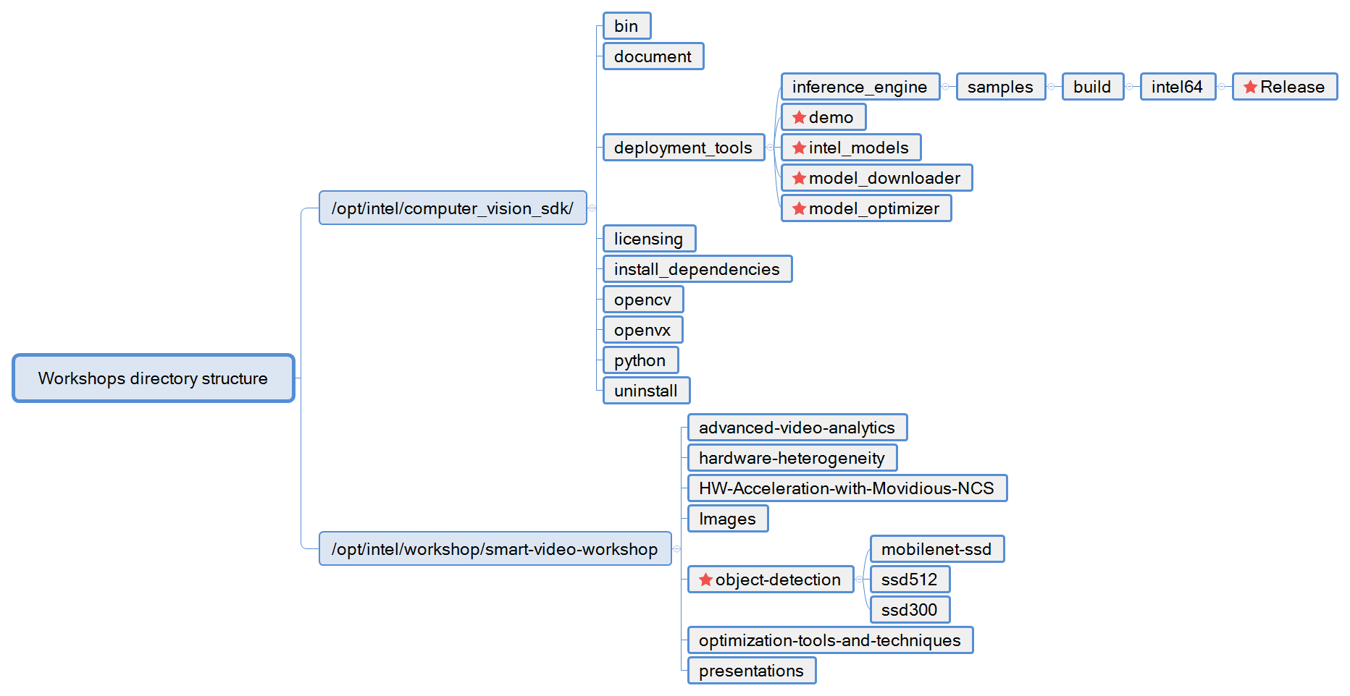
Workshops directory structure

Slide 27
Hands-on Lab ###
App Name | Type | Model (-m) | Input (-i) | Output
classification_sample | Classification | VGG19 | Image | console log
 |  | squeezenet1.1
 |  | inception-resnet-v2
 |  | densenet-121
object_detection_demo_ssd_async | SSD | mobilenet-ssd/ssd300/ssd512 | Video Cam | on screen
 |  | face-detection-adas-0001
 |  | pedestrian-and-vehicle-detector-adas-0001
interactive_face_detection_sample |  | pedestrian-detection-adas-0002 | Image Video Cam | on screen
 |  | person-detection-retail-00013
 |  | face-detection-retail-0004
 |  | person-vehicle-bike-detection-crossroad-0078
segmentation_sample | Image Segment | semantic-segmentation-adas-0001 | Image | file (out_0.bmp)
 |  | road-segmentation-adas-0001
Example:
./main.py classification_sample ­-i car.png -­m squeezenet1.1

Slide 28
Hardware Heterogenity

Slide 29
Choosing the “Right” Hardware
Power/Performance Efficiency Varies
Running the right workload on the right piece of hardware → higher efficiency
Hardware acceleration is a must
Heterogeneous computing?
Tradeoffs
Power/performance
Price
Software flexibility, portability
X100
Vision Processing Efficiency
Dedicated Hardware
Vision DSPs
X10
FPGA
Power Efficiency
GPU
CPU
X1
Computation Flexibility
Notes:
So we want to run the right task on the best, most efficient silicon device.
Considering the tight requirements for power and performance, it is obvious that in order to be competitive we must use accelerators.
But what if my workload consist of many different tasks, some tasks will run better on CPU, Some better on GPU and so on?
Can I run each portion of the code on a different device?
This is what we call Heterogeneous computing,
Balancing a workload across multiple devices is a tricky task, and need to take into account more than just the compute power of the accelerator
Transferring the data to and back from the accelerator (for example) might kill the benefit of using it at all.
How to know? Usually it’s best to just try, I’ll show an example.
So we need to consider all of these factors and more.
The good news is that Intel has a wide range of silicon solutions we can choose from…
We cannot discuss all of the tradeoffs and the options here, but let me refer you to performance.intel.com XXXXX

Slide 30
Heterogeneous Dichotomies
Data vs. Task Parallelism
Data parallelism between devices is usually explicit and extremely error-prone (like in OpenCL™).
Inference engine heterogeniety support is inherently task-oriented (node-level).
Dynamic vs. Static
User-defined work split vs. adaptive schemes (like load-balancing).
For both, there is a question on the granularity (communications costs, next).
Heterogeneity is basically Fallback.

Slide 31
Apply Device Affinities to Layers Automatically Using Fallback Policy (1 of 2)
$ object_detection_sample_ssd -d HETERO:CPU,GPU -l lib/libicv_extension.so -m ssd.xml -i snake.bmp
All IE samples support loading CPU and GPU extensions as usual (“-l” and “-c”). The “priorities” defines a greedy behavior:
Keeps all layers that can be executed on the device (FPGA)
Carefully respects topological and other limitations
Follows priorities when searching (for example, CPU)

Slide 32
Apply Device Affinities to Layers Automatically Using Fallback Policy (2 of 2)
HeteroPluginPtr plugin(make_plugin_name("HeteroPlugin"));
CNNNetReader reader;
reader.ReadNetwork(“Model.xml”);
reader.ReadWeights(“Model.bin”);
CNNNetwork network = reader.getNetwork();
plugin->SetConfig({ { "TARGET_FALLBACK", “FPGA,CPU"} }, &response);
plugin->LoadNetwork(exeNetwork, network,{}, &response);

